Slide 1
Saving the Low-Carbon Energy Transition from Magical Thinking
David M. Hart
Professor, Schar School of Policy and Government, George Mason Univ.
Senior Fellow, Information Technology and Innovation Foundation
Texas Environmental Law Journal Spring Symposium
Austin, Texas
March 24, 2017

Slide 2
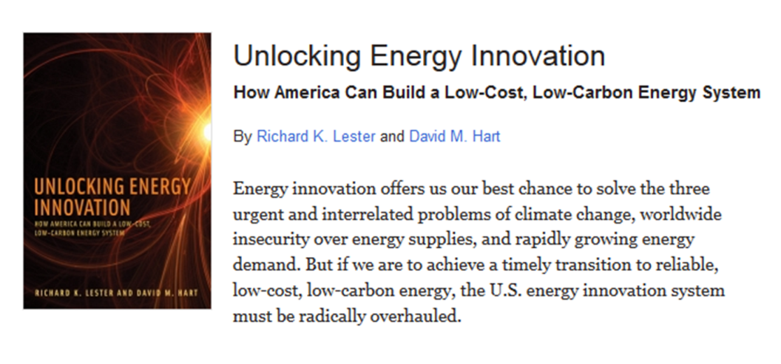
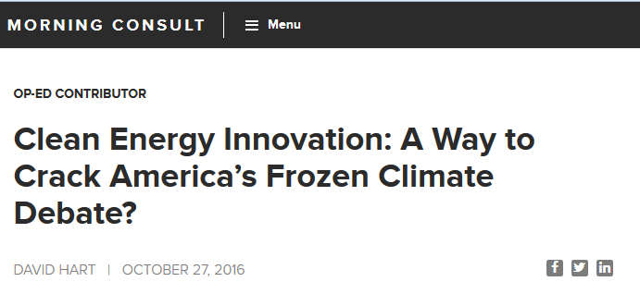

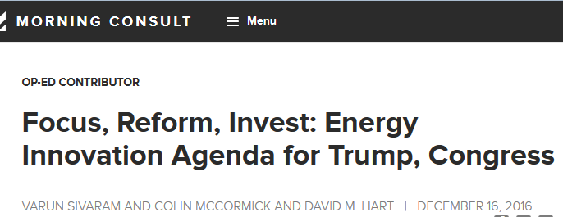

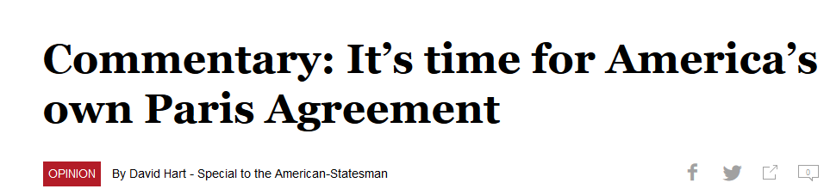

Now on Twitter!
@ProfDavidHart

Slide 3
Main Messages
Technological innovation is almost certainly necessary for the global and U.S. energy system to shift to primary reliance on low-carbon resources.
The larger the portfolio of scalable low-carbon energy technologies, the higher the likelihood of the transition occurring on the required scale.
Governments, especially the U.S. government, should invest in both “supply-push” and “demand-pull” policies to expand this portfolio.

Slide 4
Four Forms of Magical Thinking
Denial
Science-push
Premature triumphalism
Carbon price obsession

Slide 5
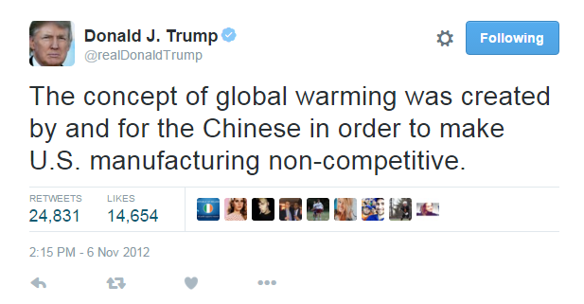
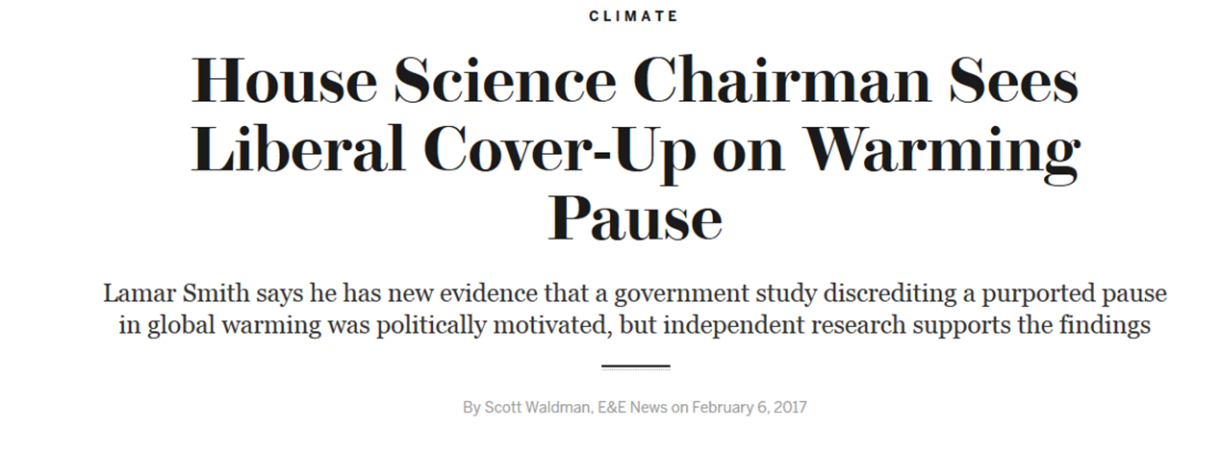
Magical Thinking Form #1: Denial

Slide 6
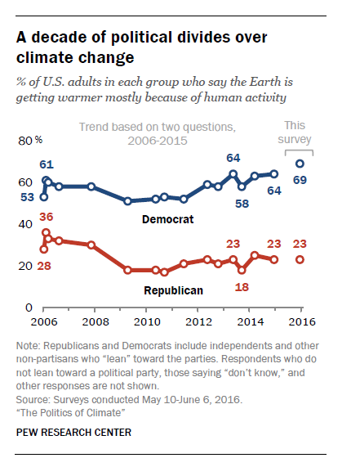
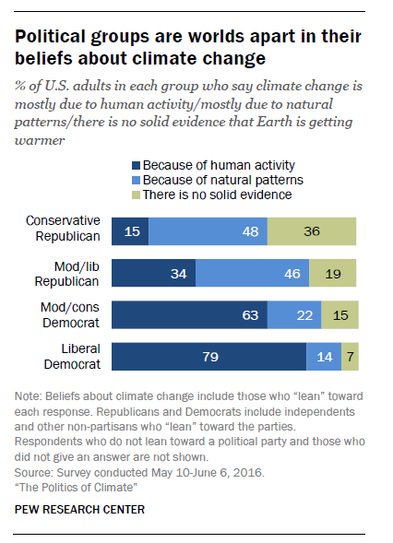
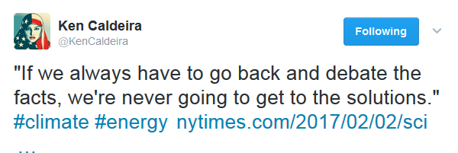
Damage Done by Denial

Slide 7

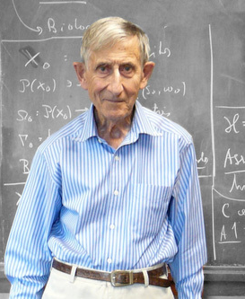
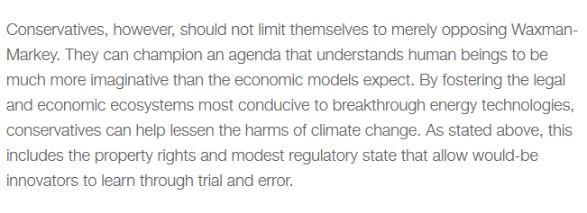

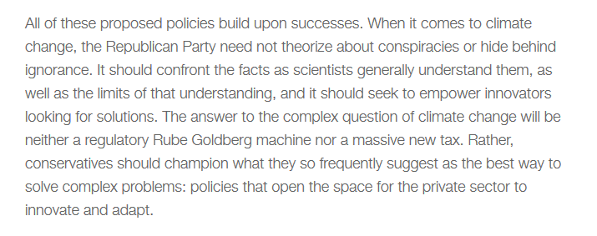
Magical Thinking Form #2: Science Push
Freeman Dyson
Jim Manzi, Manhattan Institute
After we have mastered biotechnology,” he writes, “the rules of the climate game will be radically changed. In a world economy based on biotechnology, some low-cost and environmentally benign backstop to carbon emissions is likely to become a reality.”

Slide 8
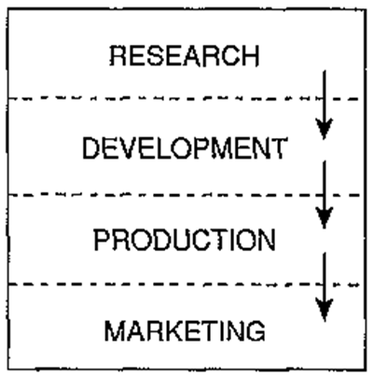
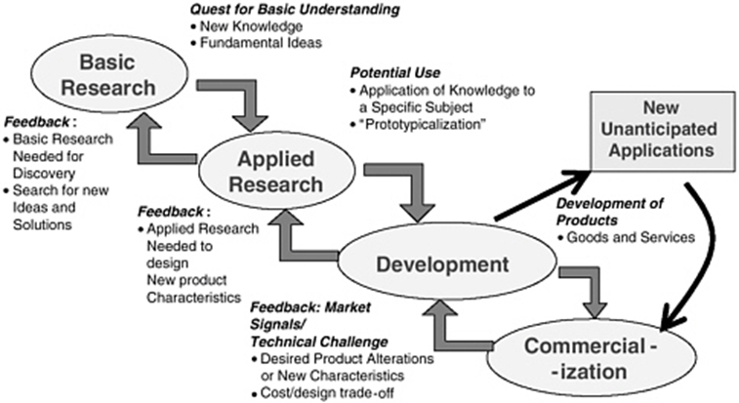
Linear and Non-Linear
Models of Innovation
Linear model of innovation
Feedback effects in the innovation process

Slide 9

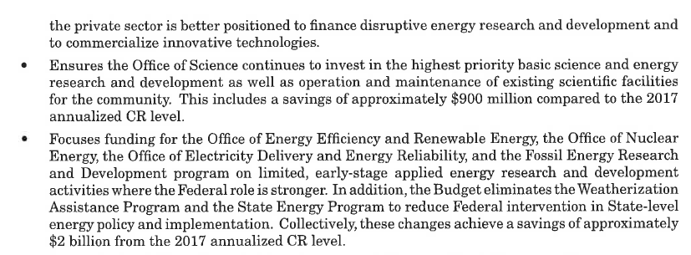
Denial + Science-Push

Slide 10
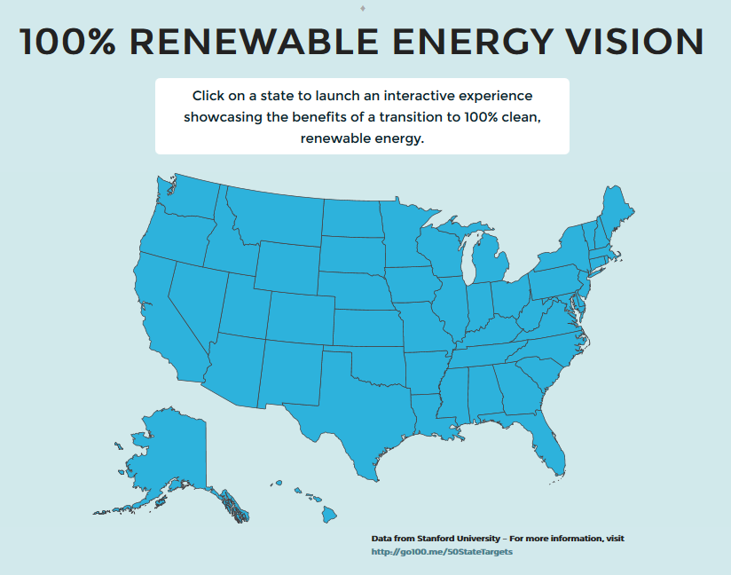
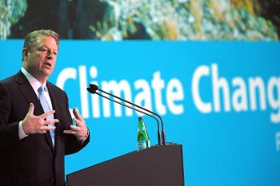
Magical Thinking Form #3:
Premature Triumphalism
Al Gore
“We already know everything we need to know to effectively address this problem. ... We have everything we need, save perhaps political will. But you know what? In America, political will is a renewable resource. We have the ability to do this. Each one of us is a cause of global warming, but each of us can make choices to change that.”

Slide 11
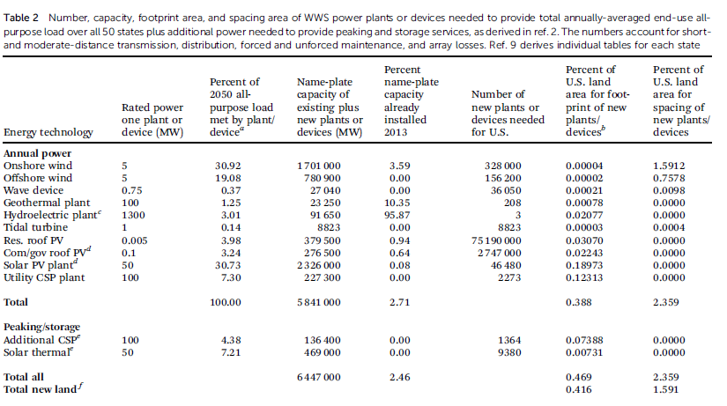
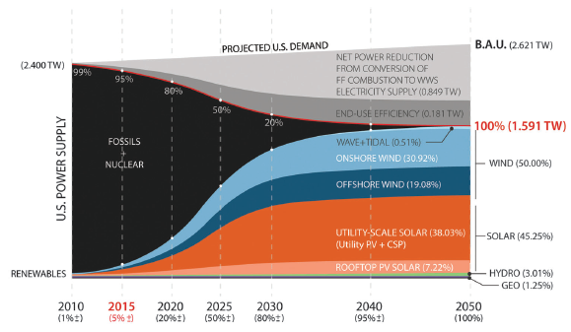

Plan or Thought Experiment?
Source: Jacobson et al. 2015

Slide 12
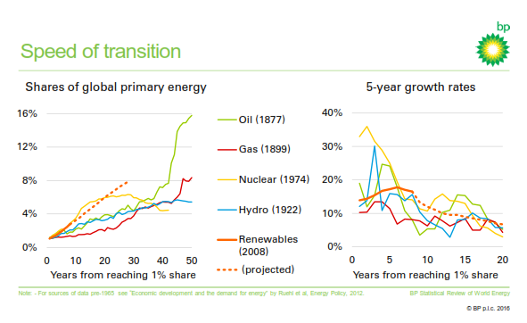
Stuff Happens When You Scale
Source: Spencer Dale, BP, June 8, 2016

Slide 13
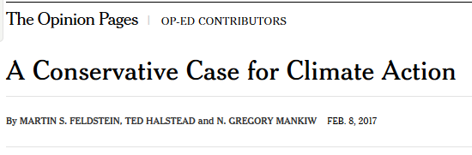
Magical Thinking Form #4:
Carbon Price Obsession
“To a first approximation, raising the price of carbon is a necessary and sufficient step for tackling global warming. The rest is largely fluff.”
William Nordhaus, 2007
“Our own analysis finds that a carbon dividends program starting at $40 per ton would achieve nearly twice the emissions reductions of all Obama-era climate regulations combined. Provided all four elements are put in force in unison, this plan could meet America’s commitment under the Paris climate agreement, all by itself.”

Slide 14
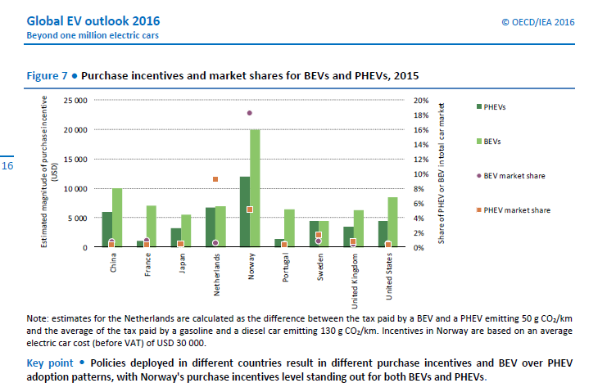
Demand Pull Alone Probably Won’t Work, or It Might Make for a Very Expensive Transition

Slide 15
An Aggressive, Smart, Low-Carbon Energy Innovation Policy Agenda that Utilizes Both “Supply-Push” and “Demand-Pull” Tools
Establish a dedicated funding source for federal low-carbon energy-innovation investments.
Steadily expand federal investment in basic research fields that have the potential to dramatically accelerate low-carbon energy innovation.
Dramatically expand federal co-investment in applied research, demonstration, and infrastructural technologies for low-carbon energy.
Enhance connectivity and strengthen user pull along the low-carbon energy-innovation chain.
Foster regional collaboration for innovation in large-scale, low-carbon energy systems.
Reform low-carbon energy tax incentives, so they are permanent and technology-neutral, and phase out support for each generation of technology as it matures.
Use federal procurement strategically to build momentum for early deployment of low-carbon energy innovations.
Encourage business-model and regulatory innovation in conjunction with technological innovation in the electricity and transportation sectors.
Tighten energy efficiency and carbon-control regulations in a predictable, innovation-inducing manner.

